Slide 1
New and Upcoming
Products and Policies - September 2024 Connectathon & WGM
Most Innovative Winner 2024 CDS Connect Challenge Agency of Healthcare Research and Quality

Slide 2
Agenda
New and Upcoming
Catalog summary
Curation team updates
Sponsorship
Policy changes
Submission process
Curation tools
Featured Demos
WildFHIR w/Richard Ettema
FHIR Candle w/Gino Canessa
Da Vinci CDex w/Preston Lee

Slide 3
Catalog Summary
67 published products 54 visible, 13 invisible
25 Da Vinci
6 FAST
4 curators
44 Apache 2.0
3 MIT
1 BSD 3-Clause
1 AGPL v3
1 PostgreSQL
0 BSD 2-Clause
0 LOINC
0 CC Attribution 4.0 Intl
0 CC Zero
0 GPL v2

Slide 4
Product Catalog Changes
Staging
Meld Community Edition
HAPI 7.4.0
Gravity Referral Source Client
Gravity EHR Server
Gravity Coordinating Platform Server
Gravity Coordinating Platform Client
Da Vinci Postable Remittance Client
Da Vinci PDex Client
Invisible, Available Products
Stack Controller
PostgreSQL 16, 15
MySQL 8
MongoDB 7
Redis 7
OpenTelemetry Collector
Jaeger
Prometheus
New!
WildFHIR – R4 Server
FHIR Candle – R4/4B/5 Server
FUME FHIR Converter
Da Vinci Postable Remittance
Da Vinci CDex
UDAP Security Server
Genomic Operations Examples
Bulk Match CLI Client
Bulk Match Server
HAPI 7.2.0

Slide 5
Curation Team Updates
Daniel Mendoza New! Clinical Informaticist providing Foundry general support and technical integrations. Available via Zulip and email.
Preston Lee
Diego Kaminker
Viet Nguyen

Slide 6
Foundry Sponsorship
Accelerators, agencies, payer, providers etc. Entities interested in accelerating broad production or adoption of published work.
Testing real PHI and real system integrations within adopter environments.
Support from Foundry team and HL7 Implementation Division on packaging, submission, publication, build updates, and adopter operation of FHIR products.
Independent technical validation and bundling within other products.
Includes Foundry-managed CI/CD deployments and infrastructure.
Contact Viet Nguyen and Diego Kaminker

Slide 7
New Policies & Best Practices for Improving Adoptability
Versioning
Avoid evergreen releases. Prefer tags for specific ballot versions.
“latest” releases should be treated as unstable CI builds for draft ballots.
Bundled products MUST lock in a specific build and configuration.
Hosted RIs for balloted IGs will need to note the IG version(s) to which it corresponds.
Stricter Dependencies
3rd-party databases use official upstream images.
Curators can only link to published build versions.
Auto-forward-migrate your schemas.
Seed data at the application level, not in database images. (Some exceptions!)
Testing & Validation
Clarifying relationships between RI versions and the IG versions they implement.
Will be incorporating objectives metrics of RI conformance.
Bundle Seeding and Control
Bundle a Stack Controller with your FHIR bundles and a “reset” button.
Currently supports WildFHIR and HAPI FHIR.

Slide 8
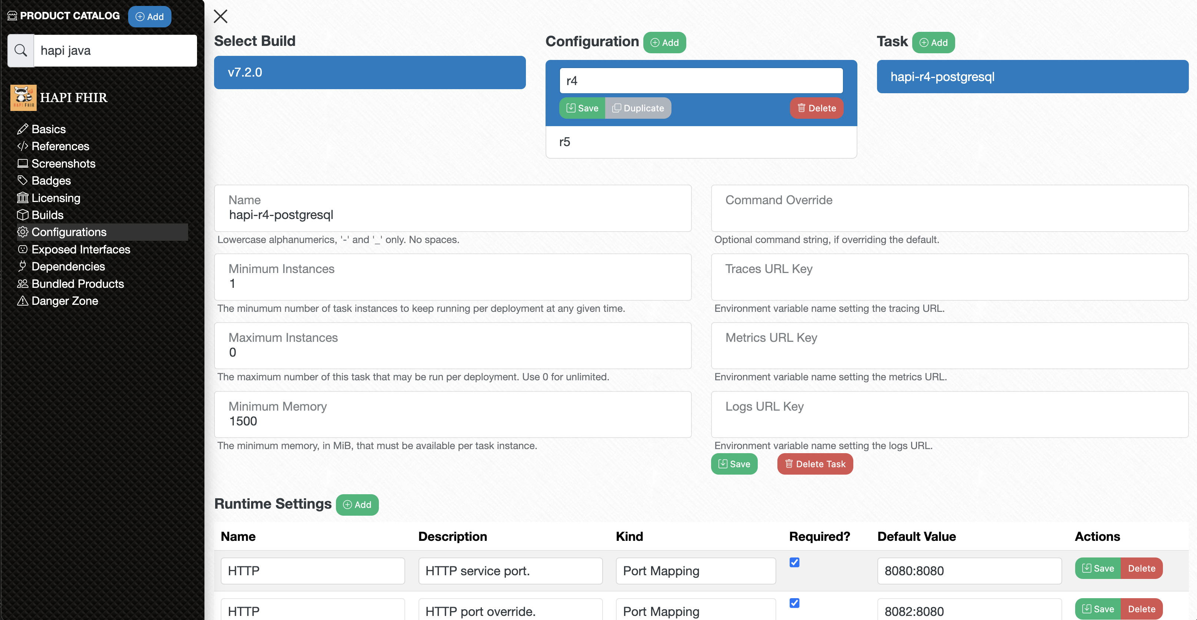
Note there is no longer a “latest” build.

Slide 9
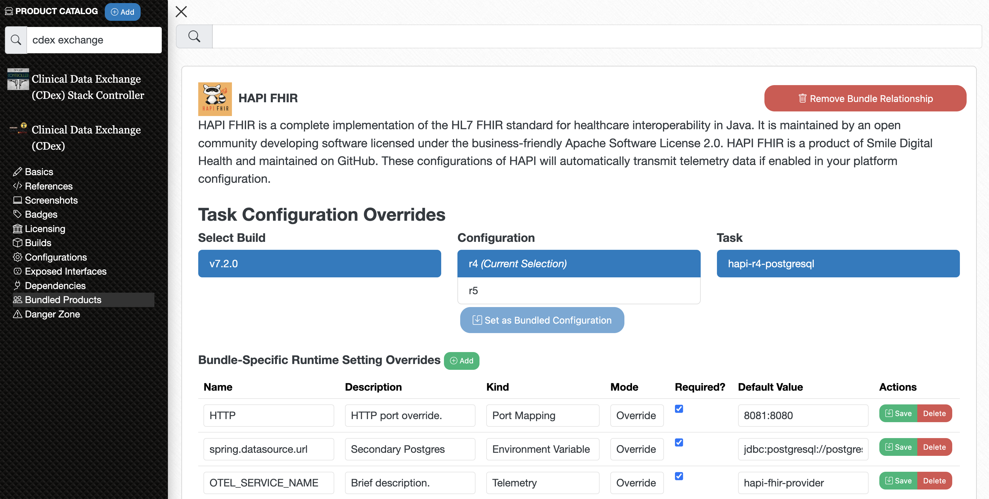

Slide 10
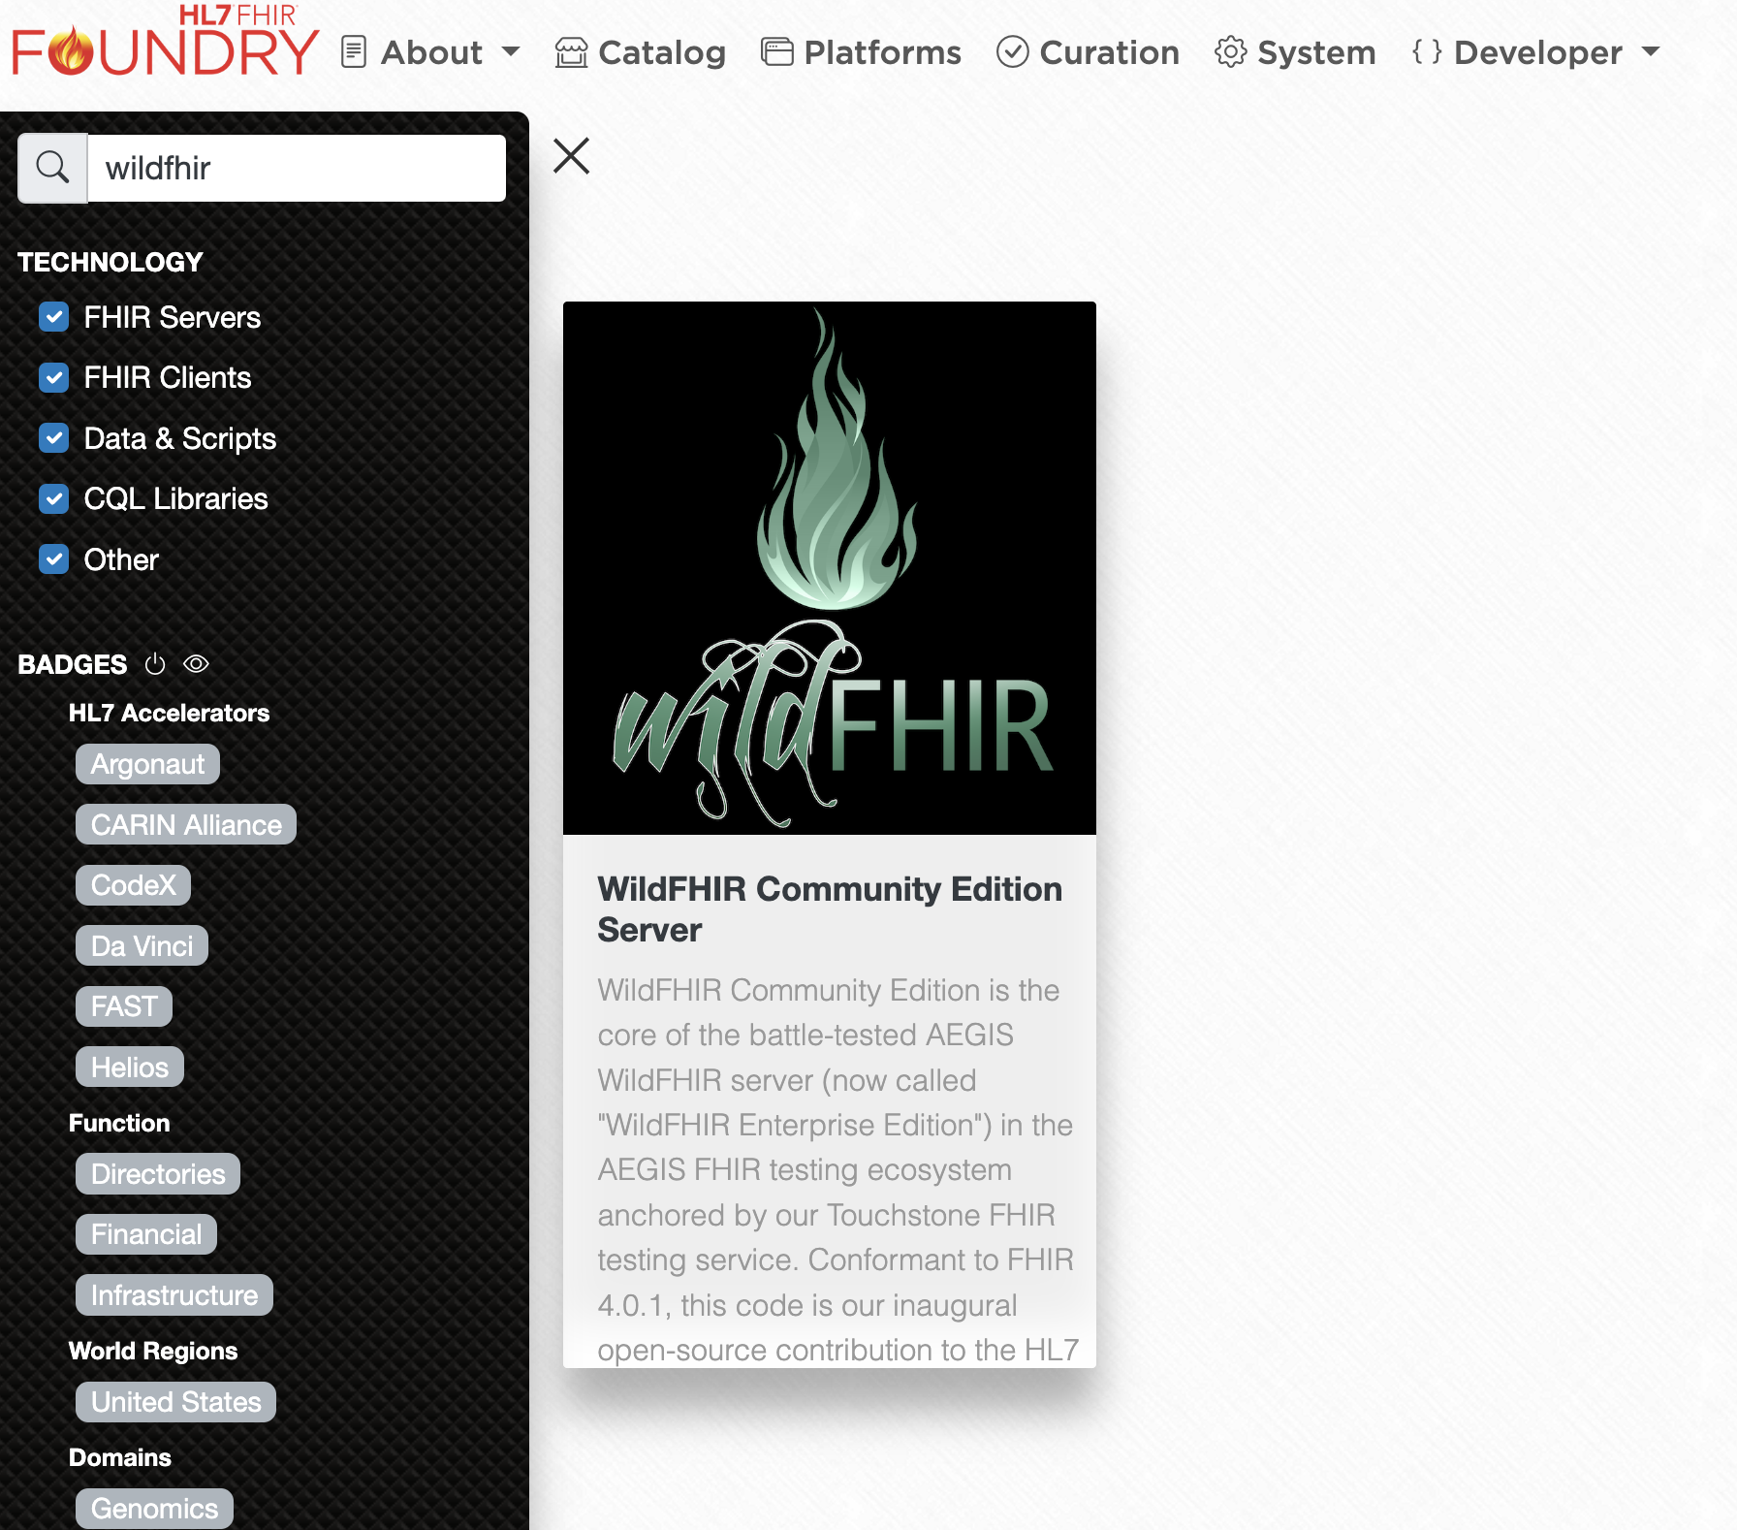
WildFHIR Demo w/Richard Ettema

Slide 11
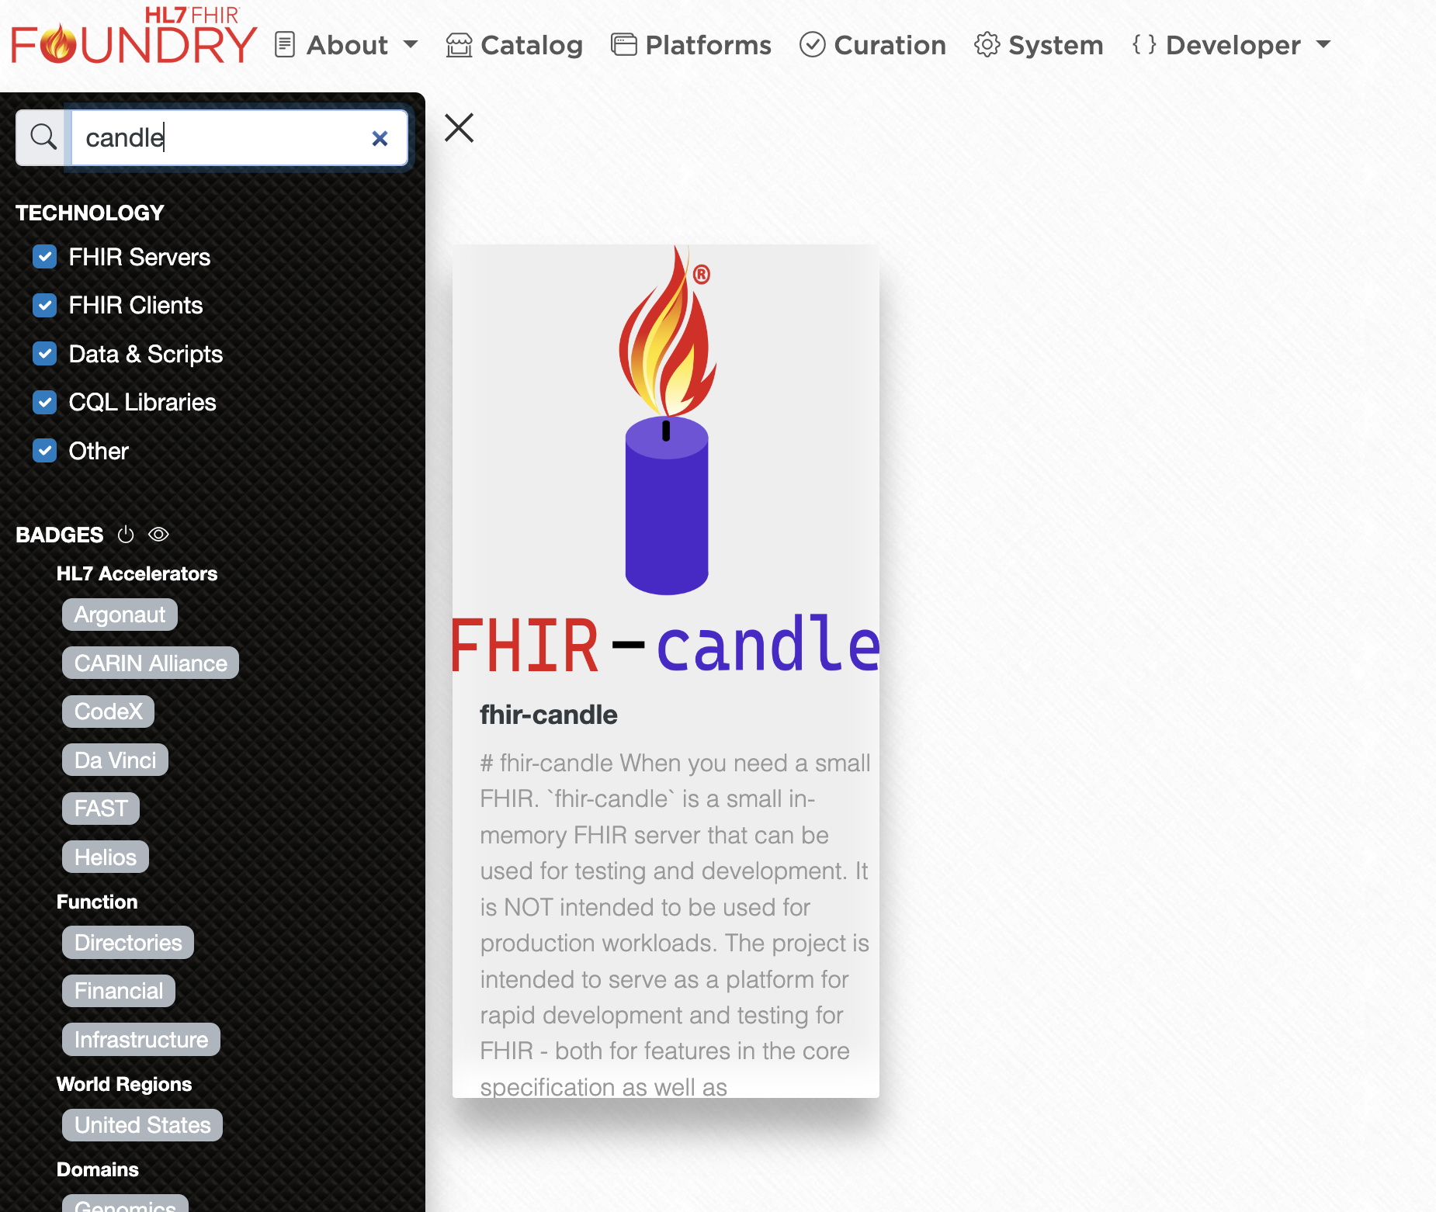
FHIR Candle Demo w/Gino Canessa

Slide 12
Questions
#Foundry on Zulip (chat.fhir.org):
@Preston Lee, preston.lee@prestonlee.com
@Daniel Mendoza, daniel.Mendoza@skycapp.com
@Diego Kaminker, diego@hl7.org
@Viet Nguyen, viet@hl7.org

